Slide 1
Integrating with Force.com
Using webhook handlers
James Hill & Luke McFarlane, Trineo Ltd, Developers // Salesforce Solutions
@oblongmana // @lukemcf

Slide 2
The Problem
Getting info from 3rd party services is tedious and not timely
Polling is hands-free, but wasteful, and not timely
Doing it manually is wasteful, untimely, and unreliable

Slide 3
The Usual Suspects
Polling
Manual Process
“Anything new yet?”
“No”
“Anything new yet?”
“No”
“Anything new yet?”
“No”
“Anything new yet?”
“No”
“Anything new yet?”
“No”
“Anything new yet?”
“No”
“Anything new yet?”
“No”
“Anything new yet?”
“No”
“Anything new yet?”
“No”
“Anything new yet?”
“YES”
*click*
*click*
*click*
*click*

Slide 4
Webhooks
User-defined HTTP callbacks
“Don’t call us, we’ll call you”
Just the events you’re interested in

Slide 5
Why?
Real-time integration
Efficiency
Quick prototyping and implementation

Slide 6








Who?
… just to name a few

Slide 7
Authentication
No common standard – read the docs
Call the service back to confirm details match
Calculate a MAC [if supported] using Crypto

Slide 8
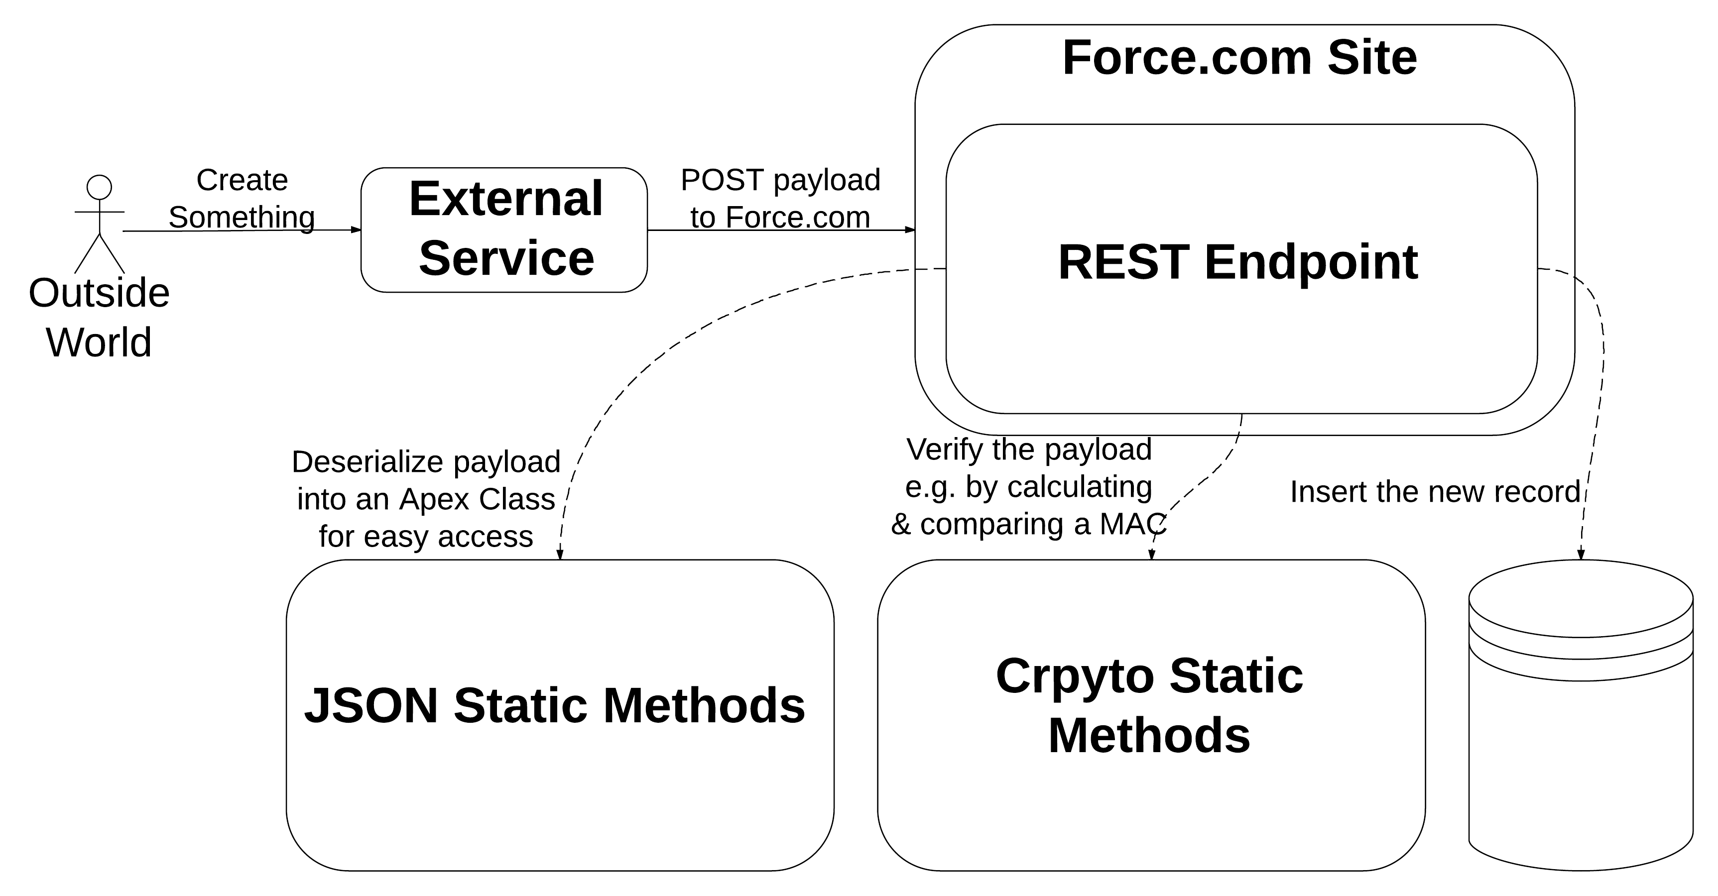

Slide 9
James Hill
Luke McFarlane
Developer // Trineo
@oblongmana
Developer // Trineo
@lukemcf
Copy our code!
Code and cliff-notes available at https://github.com/lukemcfarlane/vcg-demo

